Slide 1
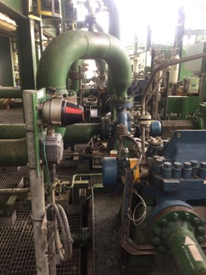
Gbaran CPF OSD1 Trip 28-05-2020
Investigation Results
Oba' Durodola, Lawson Agabi & Chidiebere Nkere)
Investigation Team

Slide 2
Outline
Problem Statement
Timeline
Findings
Conclusions and Recommendations

Slide 3
Problem Statement
Expected
Gbaran CPF to continuously produce oil and gas to deliver current CPF nomination of 1,100MMscf/d and OP19/Stretch Plan of 36,600bbl/d
Actual
Gbaran CPF experienced an OSD1 trip on 28 May 2020 at 18:13hrs
Impact
Gbaran deferred circa 780MMscf gas and 18,000bbl liquid

Slide 4
Timeline
28 May 2020
18:13: Gbaran CPF tripped on OSD1
19:20 – 21:36: Commenced Well Open up activities and pulling
22:10: High Level on the HP Flare K.O Drum due to failed 51-RV-254 on the XHP Train 2 Heater Relief Line to Flare
22:15: Closed in 12XV213/214 XHP Oil Inlet Header Train 2 to reduce fluid flow to the XHP Separator Train 2
22:30: Reset Oil Stabilization Train 1 & 2 post trip
23:00: Fully isolated the XHP Train 2 Heater and lined up the bypass
29 May 2020
02:15: Started up AGC1 post trip
05:57: AGC1 tripped
06:31: Restarted AGC1 post trip
10:39: Started AGC2 post plant trip

Slide 5
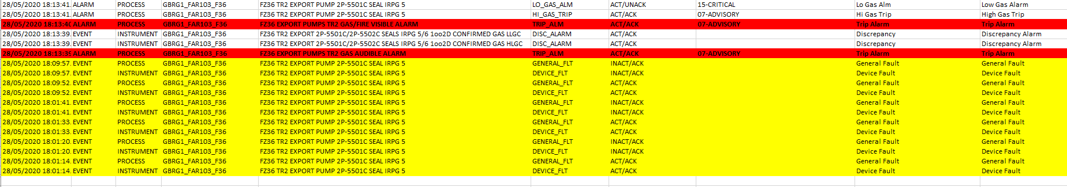
Findings
Investigations carried out by the team revealed the following;
1. OSD1 occurred at 18:13hrs due to GBRG174QS624 point gas detector at Train 2 Export Pump 2P-5501C Seal IRPG5. The Event Logs download from DCS indicate a Gas Audible Alarm at the Train 2 Export Pump as the First Out. The data is as follows;
2. The Alarm trend for the Gas Detector indicated the Detector tripped the plant at a set point of 37.2% at 18:13hrs. In Fig1 the Gas Detector started experiencing a Device Fault severally as from 18:01hrs (highlighted in yellow). The timing of the trip corelates with the time captured in the Event Logs however the required set point to activate a Trip is 60%. Reference Fig 2 for data.
Fig1 – Event Logs download from DCS

Slide 6
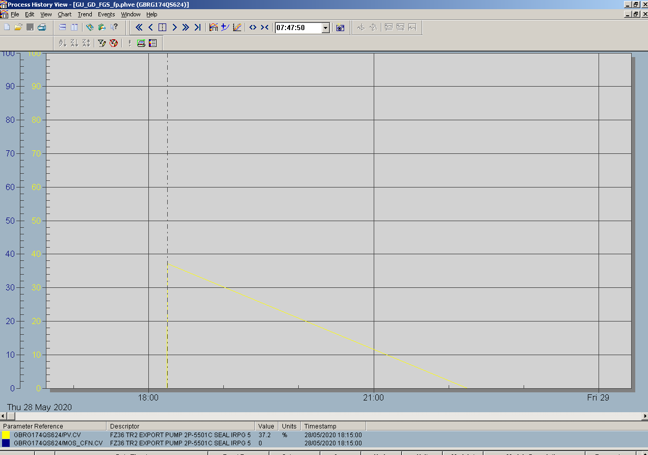
Findings
Alarm Trend indicated gas dissipated within 4hrs
Trip Point = 37.2%
Fig 2– Alarm Trend for GBRG174QS624

Slide 7
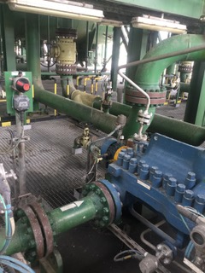
Findings
GBRG174QS624 point gas detector
3. Alarm Trends indicated a fault due to the following;
Gas detector tripped below its required trip point
Gas trends indicated 4 hours for gas to dissipate which is a deviation from normal gas envelopes recorded from trends.
4. The Gas Detector has a 1 Yearly Maintenance Cycle. The last function check was executed on 02-02-2020 with SAP W/O 22674964, its status was OK and Detector was passed Healthy.
5. Investigation Team’s visit to site indicated absence of a possible gas emission. Export Pump 2P-5501C was on stand-by when Plan tripped with 2P-5501B in operation.
6. Investigation Team performed simulation tests on 31 May 2020 at 16:10hrs to ascertain condition of gas detector. Simulation Tests indicated the following;
Gas detector failed to record gas levels above 48.4% when exposed to continuous supply of Calibration Gas. Investigation Team expected to register a 100% level due to high volumes of Calibration Gas emitted to sensor. Reference Fig 4 for data.
Fig 3– CPF Location of GBRG174QS624

Slide 8
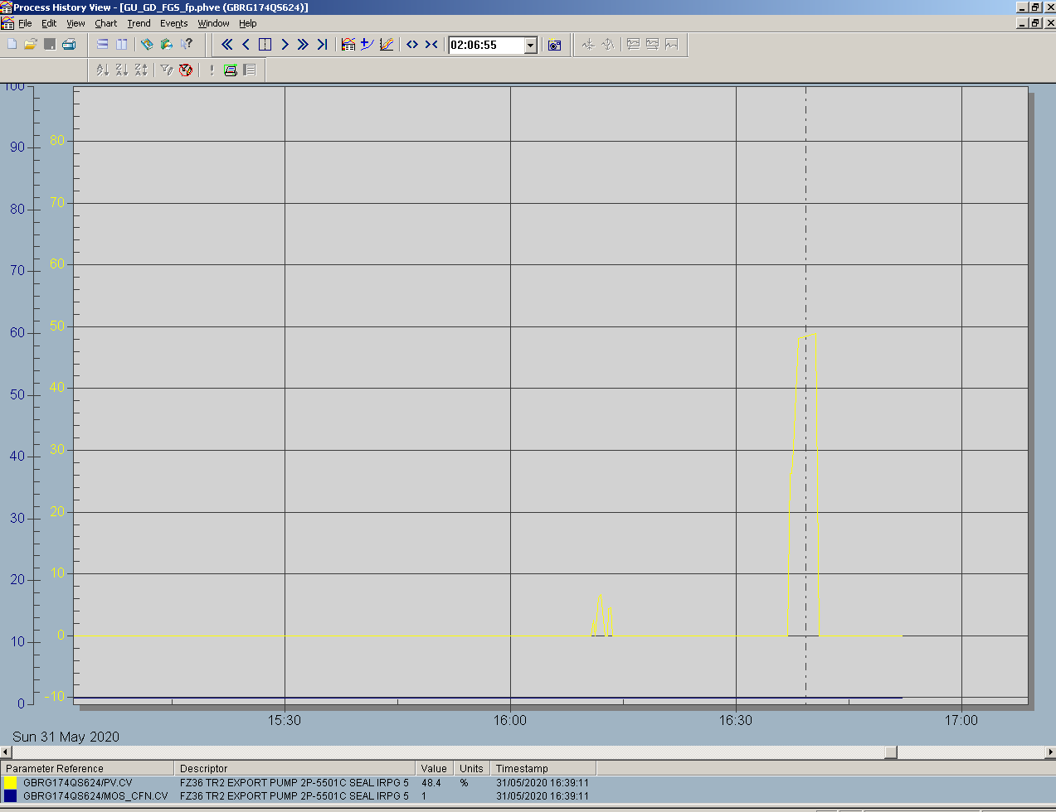
Findings
Alarm Trend indicated Gas Detector failed to record gas volumes above 48.4% during Simulation
Fig 4– Alarm Trend for GBRG174QS624 during Simulation

Slide 9
Conclusions and Recommendations
Conclusions are as follows;
1. The Gbaran CPF OSD1 on 28 May 2020 at 18:13hrs was caused by a spurious trip of GBRG174QS624 point gas detector at Train 2 Export Pump 2P-5501C Seal IRPG5.
Recommendations are as follows;
1. Replace faulty Gas Detector
2. Capture threat in MTO and perform Causal Learning

